Slide 1
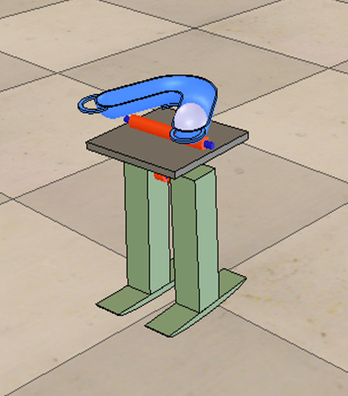
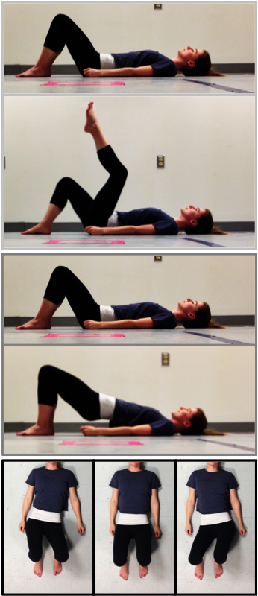
Notes:
Fix the pictures::
- May be make one with non-blue shapes

